Slide 1



Use Case Description: Dashboard
Step 0: User opens application and sees aggregated margin figures on pool level for all pools in pool currency.

Slide 2
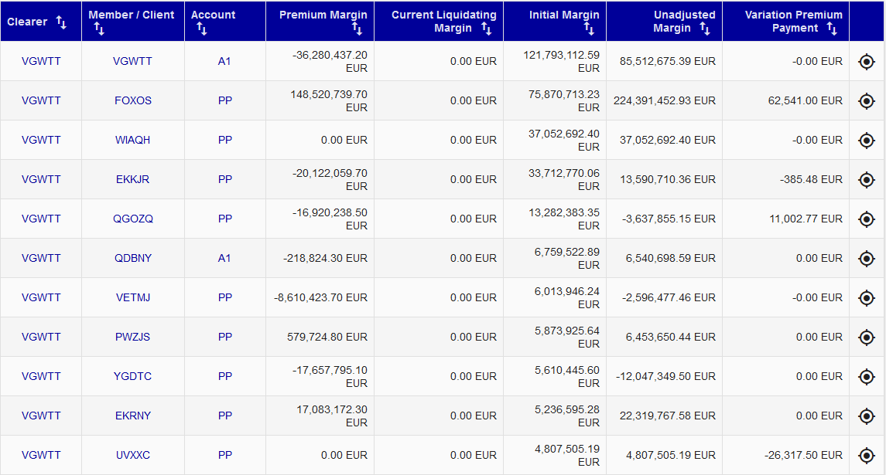
Step 1a: User clicks on Detail button
    Details of all clients and accounts associated to the pool appear

Slide 3
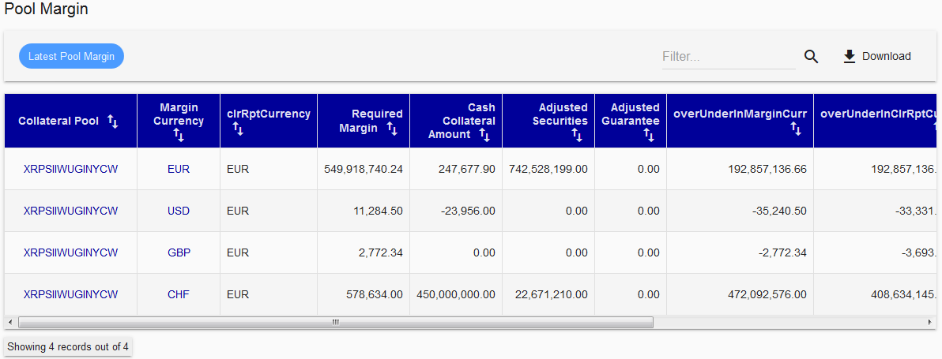
Step 1b: User clicks on pool button
    Details of pool level appear and sum over “overUnderInClrRptCurr” should be done.
    The Number is equal to Margin shortfall/surplus in the bubble.

